Slide 1
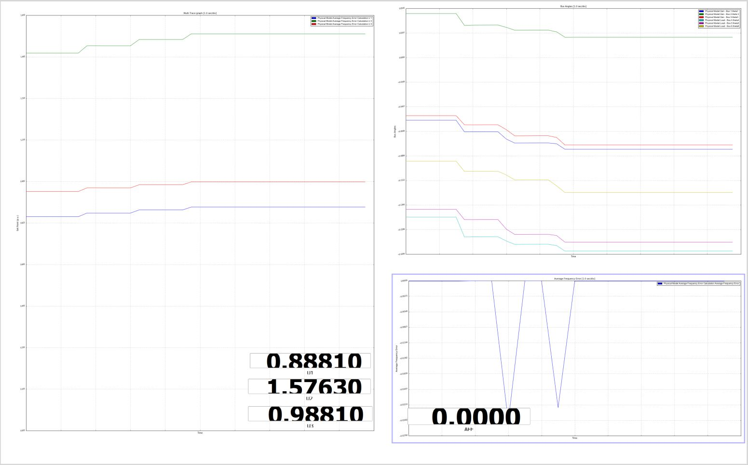
Generator Set Points
Bus Angles
Average Frequency Error

